Slide 1


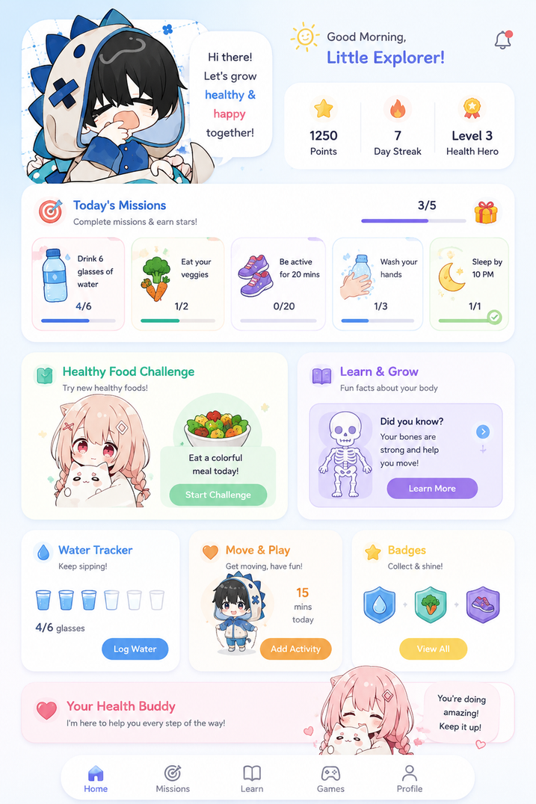
Team Name (Registered on Devfolio): CODE-RUNNERS Theme: Open Innovation
University/Institute name: Sapthagiri NPS University city/state: Bengaluru , Karnataka
Problem Statement Title: Children Learn Health Too Late
Problem Statement
Children Learn Health Too Late
Children aged 4–15 often develop unhealthy eating and hygiene habits because health education is either boring, generic, or aimed at adults. Existing solutions focus on providing information rather than helping children build lifelong healthy habits through engagement.
Proposed Solution:
BuddyBloom is an AI-powered gamified learning platform where children improve their health by completing real world challenges.
Children receive:
🥗 Daily health missions
📷 AI for knowing about thier meal
🎮 Interactive games teaching nutrition & hygiene
🦷 Habit-building challenges (brushing, hydration, exercise, sleep)
🐣 A virtual Health Buddy that grows healthier as the child develops good habits
Instead of simply teaching health, BuddyBloom transforms healthy living into an exciting adventure.
*this is an image for reference

Slide 2

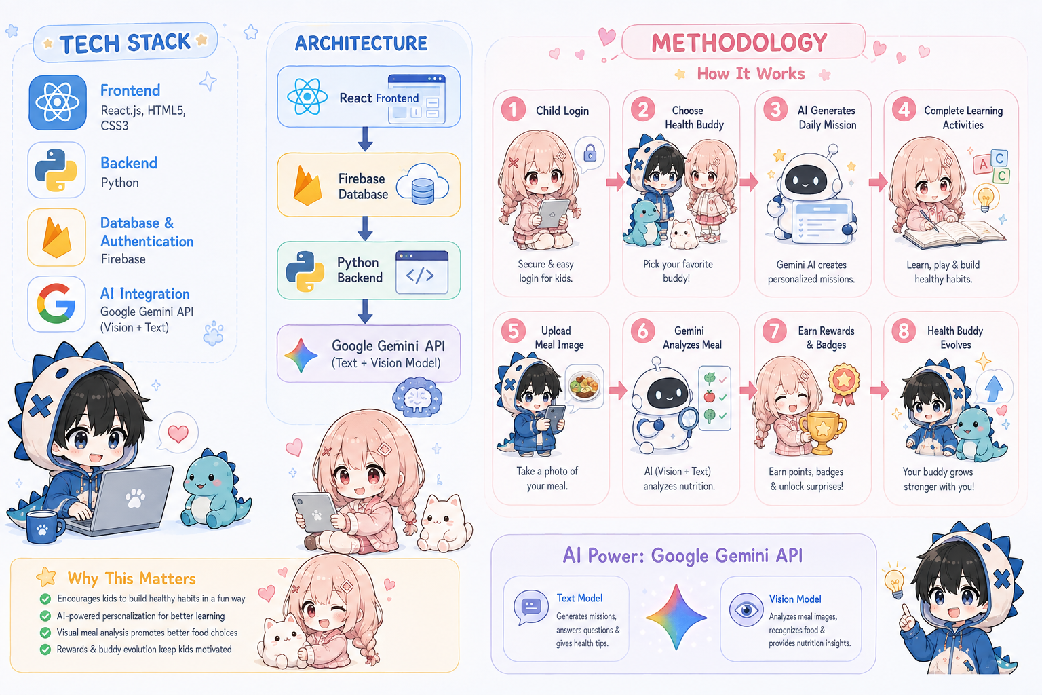
TECHNICAL APPROACH
CODE-RUNNERS
WHY THIS?
  Fast
⚡ Easy Hosting
  Smart
🤖 Gemini Vision
  Secure
🔒 Firebase
  Interactive
🎮 React
  Looks modern.
Children will love it
@DevHack Idea submission- Template
3

Slide 3

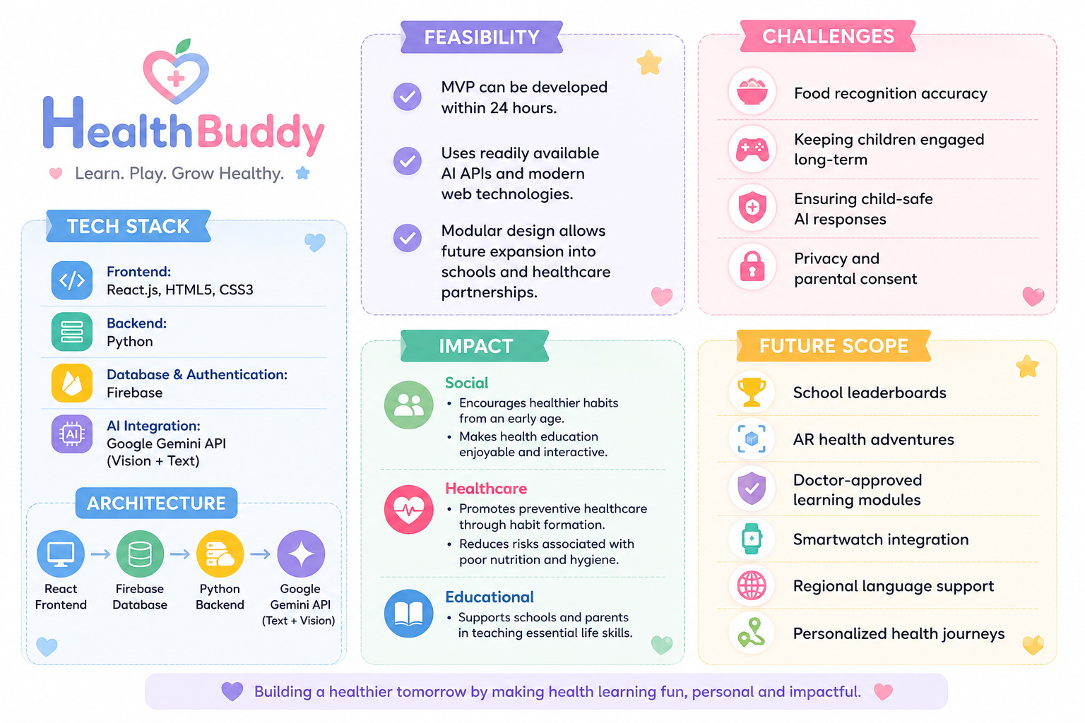

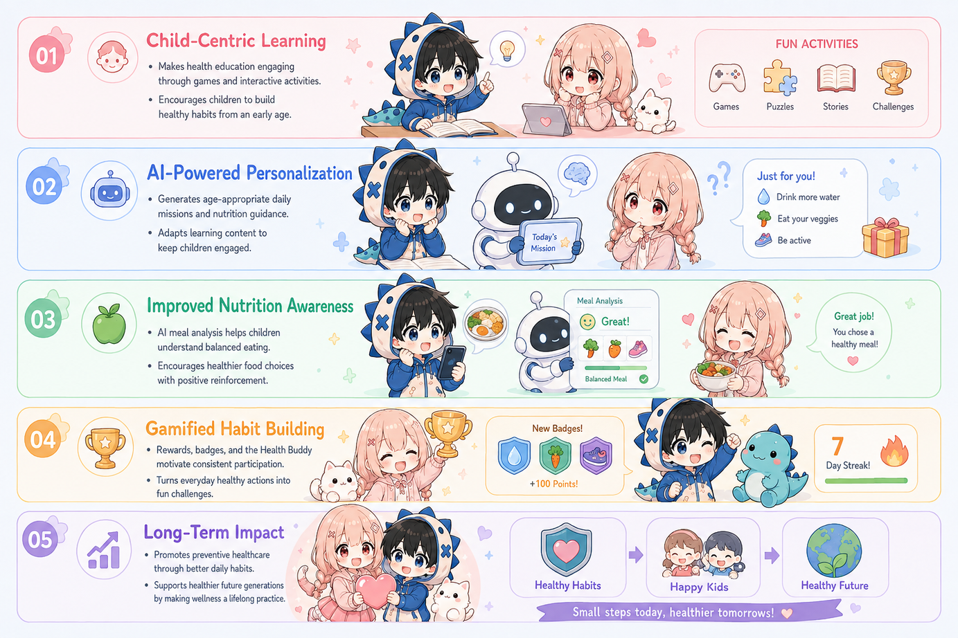
FEASIBILITY AND IMPACT
CODE-RUNNERS
Benifits:
@DevHack Idea submission- Template
4

Slide 4


